Slide 1
Money Matters:
A data mining project on
UIC undergraduate matriculation rates
and financial information
Wednesday, December 4th, 2019

Slide 2




The SMMC Data Mining Team
Smruthi Iyengar
Senior
Economics + Statistics
Hanqing Wang
Senior
Actuarial Sci & STAT
Kagen Quiballo
Senior
Math + Stats + Informatics
Yuxin Wang
Sophomore
Pre-engineering

Slide 3





The Student Success Initiative @ UIC
SSI
A large-scale project at University of Illinois at Chicago that has been going for several years
This year they are focusing on finances as a means to improve retention and matriculation for undergraduate UIC students
STUDENT SUCCESS INITIATIVE
UNIVERSITY OF ILLINOIS AT CHICAGO
UNIVERSITY STUDENT FINANCIAL SERVICES AND CASHIER OPERATIONS (USFSCO)
STUDENT MONEY MANAGEMENT CENTER
DATA MINING TEAM (INTERNS)
Notes:
The Student Money Management Center (SMMC), a division of USFSCO, empowers University of Illinois’ students to make positive behavioral changes associated with their finances. Through a multi-faceted approach that integrates comprehensive online and in person platforms, they ensure students take control over their financial futures.

Slide 4
Presentation Overview
SECTION I.
Summarize the data
sample size
demographics
enrollment rates
SECTION II.
Analyze the data
representative sample
matriculation rates
financial holds, aid, costs
SECTION III.
Predictive analysis
matriculation rates
financial holds, aid

Slide 5
SECTION I.
Summarize the data
sample size UIC undergraduate students (2017-2019)
demographics gender, residency, year in school, college
dropout rates semester & yearly (2017-2019)
Notes:
Be more clear about dataset timeframe
Be mindful about color contrasts (greyscale test)

Slide 6
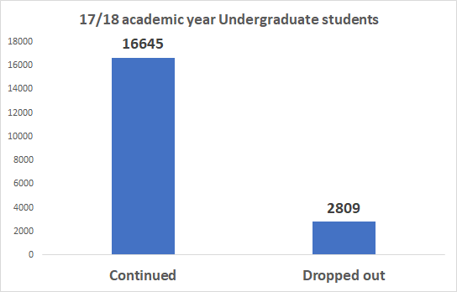
Sample Size
Total : 19454
Sample contains all undergraduate students who enrolled Fall 2017
Drop-out sample contains who choose not to continue their education at any point from the beginning of Fall 2017 to the end of Spring 2018
Notes:
There are total 19454 undergraduate students in the sample. Among those, there are 16645 students who continued from 17/18 academic year. There are 2809 students who chose not to continue their education at any point from the beginning of Fall 2017 to the end of Spring 2018

Slide 7
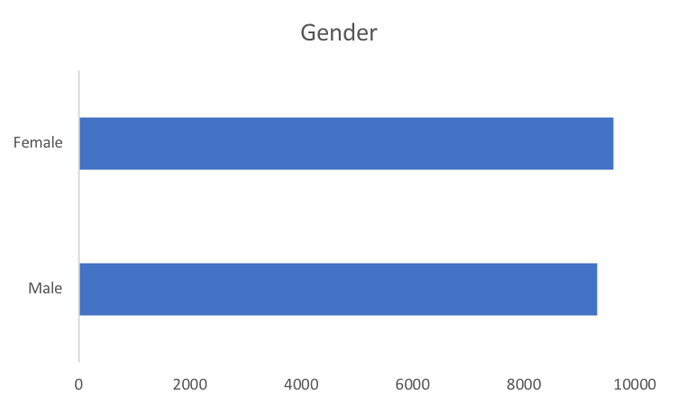
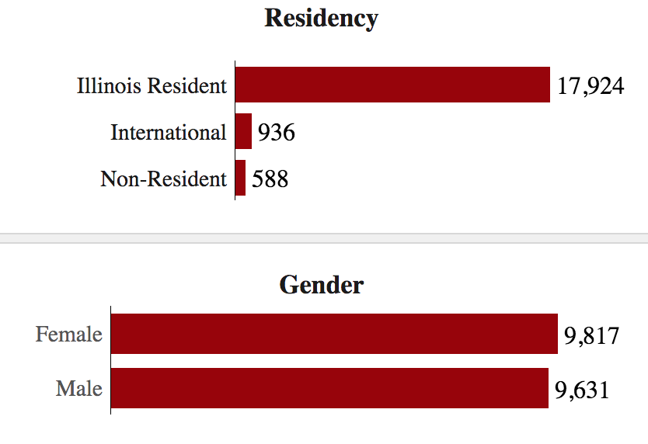
Demographics: Gender
50.8%
9,614
BANNER DATA
49.2%
9,325
50.5%
UILLINOIS
49.5%

Slide 8
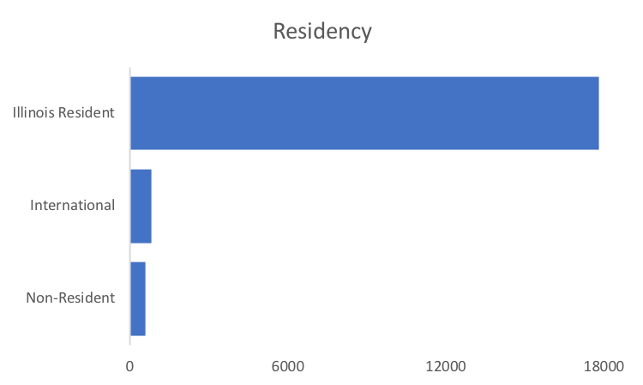
Demographics: Residency
92.7%
17,826
BANNER DATA
821
577
92.2%
UILLINOIS

Slide 9
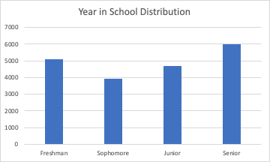
Demographics: Year in School
Most Students are seniors (n = 6,000)
Sophomores have the smallest amount of students (n = 4,000)

Slide 10
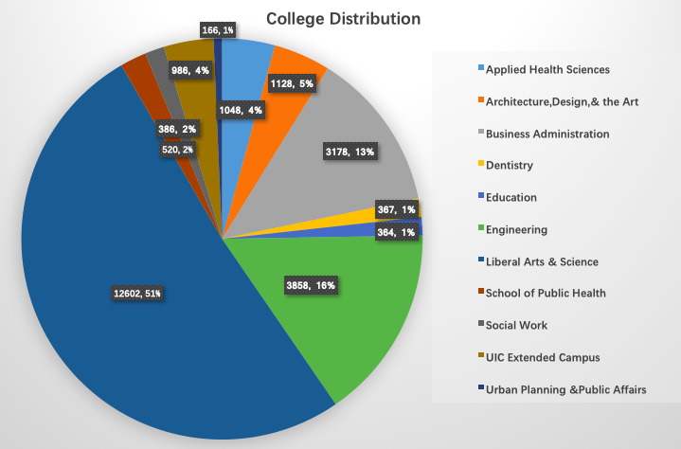
Demographics: College
Most students choose to study in:
Liberal Arts & Science
Engineering College
Business College
Notes:
In this section we focus on the college distribution info. we identify that there are total 12602 students who enrolled in Liberal Art & Science College, which makes up a significantly higher representation of our sample making up 51% of the population. The second largest college is Engineering College. But compared to LAS College, the percentage of Engineering College is lower, which is about 16%. And the third largest college is Business College, making up 13% of the total population. The number of students in Applied Health Science, Architecture Design & Art, and UIC Extended Campus are about the same. And among the rest colleges, students are evenly distributed. Those colleges makes up a small representation of our sample, each making up only 1% of the population.

Slide 11
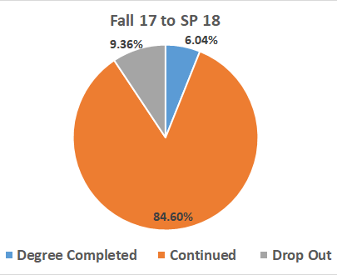
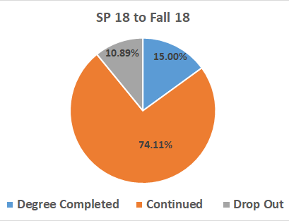
Drop-out Rates (by Semester)
Drop-out
Drop-out + Continued
 | Fall 17 to SP 18 | SP 18 to Fall 18
Drop Out Rate | 9.96% | 12.81%
Notes:
For this slide, we are going to talk about drop rate semester by semester. In each pie chart, the orange part means the proportion of students who continued, grey part indicates the proportion of students who dropped out and blue part means the proportion of students who graduated. From Fall 2017 to Fall 2018, there is 9.36% of students dropped out. The drop-out rate, which is the proportion of students who dropped out among the students who should continue, is 9.96%. From Spring 2018 to Fall 2018, There is 10.89% of students dropped out. The drop out rate is 12.81%.

Slide 12
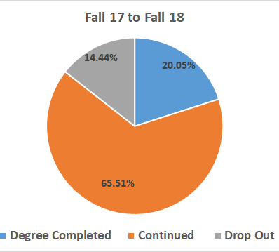
Drop-out Rates (Yearly)
Drop-out
Drop-out + Continued
 | Fall 17 to Fall 18
Drop Out Rate | 18.06%
Notes:
In the next slide, we have yearly drop out rate report. From Fall 2017 to Fall 2018, there is total 14.44% students who dropped out. The drop out rate is 18.06%. I can see students tend to drop out in spring

Slide 13
Key Takeaways from Section I
The gender distribution of students in the sample is about even.
A large majority of the population are in state students.
The year in school distribution is about even but a majority of students are seniors and sophomores have the least amount of students.
Over half of the students are in LAS.
Dropout rates are higher from the spring semester of 2018 to the fall semester of 2018 compared to the fall semester of 2017 to the spring semester of 2018.
Notes:
For this slide, we are going to talk about drop rate. In three pie chart, the orange part means the proportion of students who continued, grey part indicates the proportion of students who dropped out and blue part means the proportion of students who graduated. From Fall 2017 to Fall 2018, there is same amount of undergraduate students who dropped out as the undergraduate students who graduated. The drop out rate, which is the proportion of students who dropped out among the students who should continue, is 7.45%. From Spring 2018 to Fall 2018, There is 8.86% of students dropped out. The drop out rate is 10.47%. From Fall 2017 to Fall 2018, there is total 13% students who dropped out. The drop out rate is 15.35%. I can see students tend to drop out in spring. (separate (Fall 2017 to Fall 2018) part)

Slide 14
SECTION II.
Analyze the data
representative sample banner, census
matriculation rates semesterly (2017-2019)
financial variables financial holds, financial aid
cost of attendance costs by college, by major

Slide 15
Representative Sample
Undergrad students at UIC enrolled between Fall 2017 and Spring 2019
REASONS
Possible to register for 0 credit hours and still be enrolled (internships, etc)
Census is a snapshot on 14th day of classes and may not show students who drop out afterwards
BANNER DATA
18,976 students
CENSUS DATA
19,454 students
Demographics data accurate within 0.5% error

Slide 16
Matriculation Rates by semester
METHODS
UNDERGRADS
accurate & representative
accuracy
matched demographics within 0.5%
example
blanks in S18 →
look for refund during
active term (F17)
REFUND
for corresponding term
CREDIT HOURS
no blanks/0s → blanks/0s
blank (did not register)
0 (registered and dropped, there are a few exceptions)

Slide 17
Matriculation Rates by semester
Total dropout from F17 to S19
8,360 = 44.1%
18,976
students
dropout:
2,491 students
dropout:
3,904 students
dropout:
1,965 students
F17
S18
F18
S19
13.1%
20.6%
10.4%

Slide 18
UG Discontinue: at least 1 semester
PREVIOUS SLIDE
F17 | S18 | F18 | S19 | COUNT | REFUND TUITION
 | did not continue |  |  | 2,491 | 1,231 (49.4%)
 |  | did not continue |  | 3,904 | 2,545 (65.2%)
 |  |  | did not continue | 1,965 | 976 (49.7%)
*overlap of 108 students in rows 1 & 3

Slide 19
UG Discontinue: ‘complete dropout’
F17 | S18 | F18 | S19 | COUNT
 | did not continue |  |  | 2,069
 |  | did not continue |  | 3,643
 |  |  | did not continue | 1,857
 |  |  |  | 10,724

Slide 20
Matriculation Rates by semester
F17 | S18 | F18 | S19 | COUNT
 | skip 1 |  |  | 375
 |  | skip 1 |  | 261
 | skip 2 |  |  | 47

Slide 21
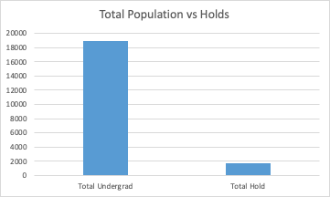
Financial Holds
1655 undergraduates had a hold
9 percent of total population

Slide 22
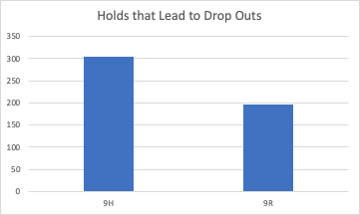
Financial Holds
(how many students cannot continue)
499 students can not continue due to a financial hold.
Most have 9H hold (n = 303)
Notes:
9H over 200 dollars!

Slide 23
Cost of Attendance
What is the average cost of attendance for the sample?
Registration Fee: 578$
Registration Tuition: 5640$
Notes:
Based on the banner and census data, we calculated the average registration tuition and fees based on college. we wanna figure out whether the cost of attendance is a factor that can impact the matriculation rate from Fall 2017 to Fall 2019.

Slide 24
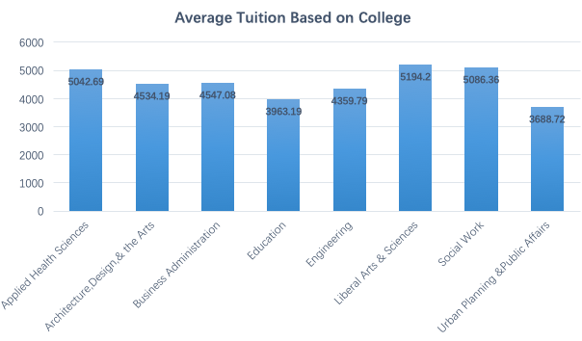
Cost of Attendance
(based on college)
Notes:
The numbers in the above graph represent the average tuition and fees in each college in dollars. As you can see, Liberal Arts & Science has the highest average tuition and fees. And the School of Urban Planning & Public Affairs has the lowest average tuition fees, which is about 1506 dollars less than the tuition and fees of Liberal Arts & Science. The School of Social Work has the second highest tuition and fees, which is pretty much the same as the cost of School of Applied Health Sciences.

Slide 25
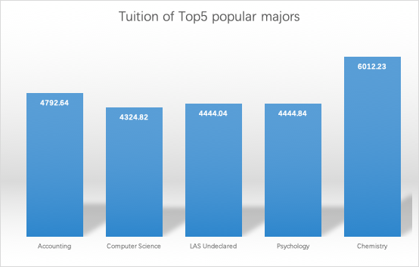
Cost of Attendance
(based on major)
Tuition of Top 5 popular majors:
Chemistry
Accounting
Psychology
Computer Science
LAS Undeclared
Notes:
Moreover, we calculated the average tuition and fees based on majors. We chose the top five popular majors to analyze, which means those five majors have the highest number of students enrolled. As you can see in the above graph, chemistry has the highest average tuition and fees among the five majors. The second highest is accounting, but it still costs about 1220 dollars less than chemistry does. And the costs of the other three majors(Computer Science, LAS Undeclared, and Psychology) are roughly the same.
We related the information of cost of attendance to the matriculation rate mentioned previously. There is no strong relationship between the cost of attendance and the dropout rate except the LAS College. However, we can say that the cost of attendance should be considered as a factor that can impact the matriculation rate from Fall 2017 to Fall 2019.

Slide 26
Key Takeaways from Section II
The total drop out rate from Fall 2017 to Spring 2019 is as high as 44.1%
The Cost of attendance for Chemistry major is the highest among all majors
Senior and junior have the highest proportion of students who receive the financial holds
Notes:
Correlate
purpose

Slide 27
SECTION III.
Predictive analysis
financial holds
by college, by degree, predicted by account charges or authorized payer
financial aid by college, by degree
matriculation rates by funding type
Notes:
In this section, we will be applying statistical analysis techniques to study the hidden pattern within the data set. First, we will talk about whether students have higher chance to receive a financial hold in a specific college or degree program. Then, we will talk about whether a student would be more likely to receive a financial aid if the student is enrolled in a specific college or degree program. Third, we want to see what type of charges incurred in the past is correlated to the future likelihood of getting a financial hold. Also, we will see how would having an authorized payer would do to the chance of getting a financial hold. Finally, we want to study how would different funding methods impact differently to the student matriculation.

Slide 28
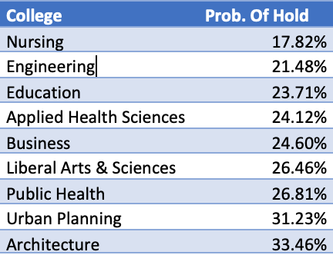
Financial Holds
(students from dif college/degree more likely to have one)
Nursing and Architecture are the only ones Statistically Different from the mean probability of having a hold (25%)
Nursing P value = 0.00651
Architecture P Value = 0

Slide 29
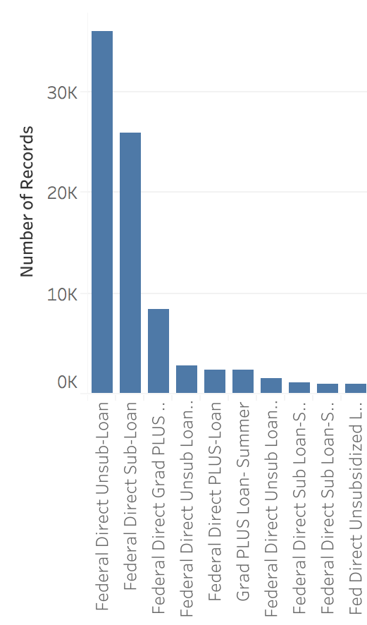
Financial Aid by college
Top 10 Loan Names are
Federal Direct (external)
19,454 undergrads 1718 yr
INSTITUTIONAL
EXTERNAL
BENEFITS
EXEMPTIONS
WAIVERS
SCHOLARSHIPS
PRIZE/AWARD
UIC GRANT
SCHOLARSHIP
(has ‘External’ in desc.)
GRANT
LOAN
WORK
5,611 students
14,640 students
Notes:
Top loans - direct ones are federal (external) plus (federal) perkins are (federal) 89%

Slide 30
Financial Aid by college: External
COLLEGE | STUDENTS IN COLLEGE | HOW MANY RECEIVED AID | PERCENTAGE RECEIVED AID | AVG AMOUNT ($)
LAS | 9,691 | 7,618 | 78.61% | 13,375
Engineering | 3,604 | 2,430 | 67.43% | 14,743
Business | 2,987 | 2,207 | 73.89% | 13,455
Arch/Design/Art | 1,064 | 792 | 74.44% | 14,762
App. Health Sci | 999 | 765 | 76.58% | 13,235
Nursing | 477 | 318 | 66.67% | 17,438
Education | 388 | 328 | 84.54% | 12,549
Urb Planning | 147 | 104 | 70.75% | 15,148
Public Health | 97 | 78 | 80.41% | 14,445
ALL COLLEGES | 19,454 | 14,640 | 75.25% | 14,350
KEY FINDINGS
Inverse relationship between percentage and avg amount
Reason: more money to give to less people

Slide 31
Financial Aid by college: Institutional
COLLEGE | STUDENTS IN COLLEGE | HOW MANY RECEIVED AID | PERCENTAGE RECEIVED AID | AVG AMOUNT ($)
LAS | 9,691 | 2,707 | 27.93% | 4,632
Engineering | 3,604 | 1,034 | 28.69% | 4,772
Business | 2,987 | 1,054 | 35.29% | 4,824
Arch/Design/Art | 1,064 | 277 | 26.03% | 4,868
App. Health Sci | 999 | 276 | 27.63% | 4,696
Nursing | 477 | 75 | 15.72% | 4,456
Education | 388 | 95 | 24.48% | 4,075
Urb Planning | 147 | 31 | 21.09% | 4,322
Public Health | 97 | 62 | 63.92% | 5,910
ALL COLLEGES | 19,454 | 5,611 | 28.84% | 4,728
KEY FINDINGS
Approximately same average amount except for Public Health
Nursing lowest % for both types
Public Health highest % for both types
Institutional: fair allocation

Slide 32
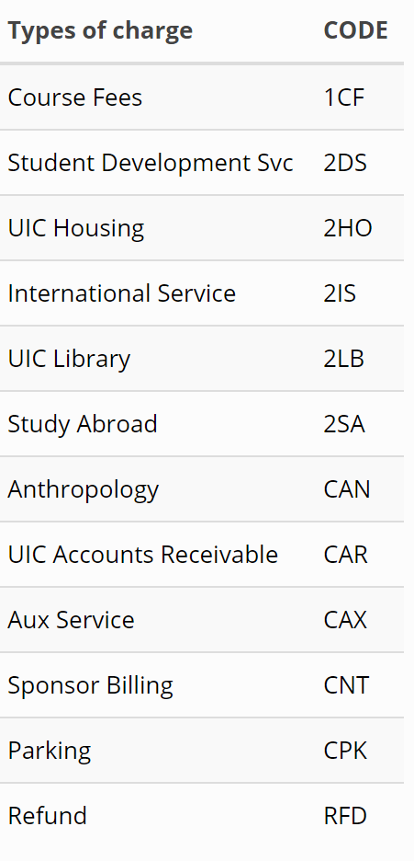
Financial Hold
(predicted by charges)
One model predicting hold based on previous semester charge incurred
None, Some
One model predicting which type of hold based on previous semester charge incurred
None, 9H, 9R, Both
Notes:
We were able to adapt some statistical learning techniques to predict the financial hold based on different types of charges. We used the total charges incurred for each type and each student in Fall 2017 to predict the hold in spring 2018. The table in the right side of the slide contains all the types of charges that occurred on more than 10 students in fall 2017, which is also the predictive variables we used in the model training. There are two types of response variables. One classifies students either has hold or has no hold. Another one classifies students based on which type of hold they get. Thus, we will have two models.

Slide 33
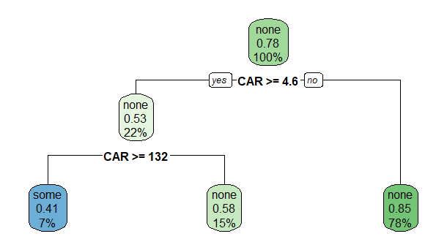
Model #1 charge predict Hold
Among 11 types of charge, late fee charge (CAR) is significant for predicting hold
When total late fee charge incurred exceeds 132 in fall 2017, the student has 41% chance ends up with at least 1 hold in Spring 2018
Notes:
The first model is the decision tree.

Slide 34
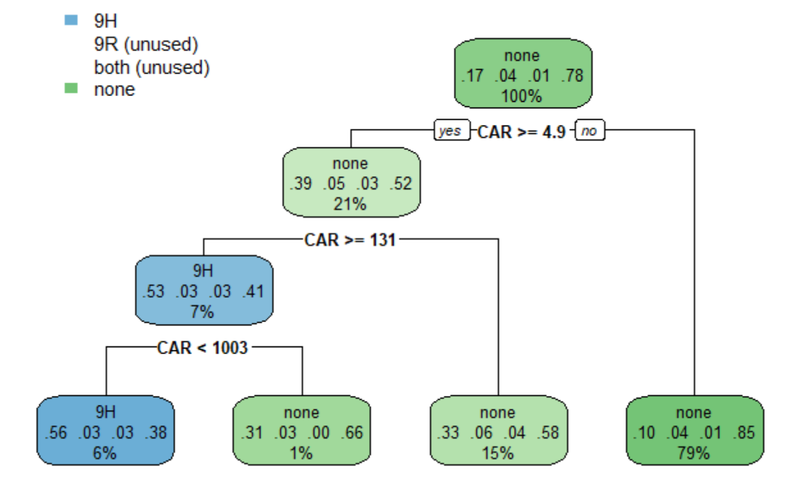
Model #2 charge predict Hold
late fee charge (CAR) is significant for predicting hold
When total late fee charge incurred exceeds 131 in fall 2017, the student has 56% chance ends up with 9H hold in Spring 2018

Slide 35

Financial Hold
(having an authorized payer: more or less likely to have a hold)
Methodology - Regression Model
There is no statistically significant difference between students who have a authorized payer vs students that don’t.
P value = 0.0634

Slide 36
Matriculation Rates: Loans (F17/S18)
9,831 students (50.5%)
89.2% continue
receive NO offer
of a loan
10.8% withdraw
Students who are offered loans are
less likely to withdraw the
next semester
92.1% continue
receive offer
of a loan
7.9% withdraw
9,623 students (49.5%)
Notes:
And students loans turn into debt - different implications

Slide 37
Matriculation Rates: Financial Aid (F17/S18)
NOT including loans
5,923 students (30.4%)
87.8% continue
receive NO offer
of any aid
12.2% withdraw
Students who receive aid are
less likely to withdraw the
next semester
91.9% continue
receive offer
of aid
8.1% withdraw
13,531 students (69.6%)
Notes:
Excluding loans verbalize

Slide 38
Matriculation Rates: Payment (F17/S18)
6,700 students (34.4%)
91.3% continue
Did NOT need to make a payment to account
8.7% withdraw
Students who have to make payments are
more likely to
withdraw the
next semester
90.3% continue
Needed to
make a payment to account
9.7% withdraw
12,754 students (65.6%)

Slide 39
Key Takeaways from Section III
Students from nursing program is less likely to receive a hold
College of public health would be always on the top two colleges who have the highest proportion of students receiving financial aid
Having an authorized payer would only show the difference between payment method other than payment ability
Students who are offered with loans or financial aid are less likely to drop out
Also, students who have to make payment are more likely to withdraw from the college
Notes:
Overall, we can see when it comes to financial hold, students from nursing program is less likely to receive a hold. In contrast, students from architecture program would have the highest probability of getting a hold among all other programs and colleges. having an authorized payer will not help reduce the chance of getting a financial hold. Having an authorized payer would only show the difference between payment method other than payment ability.
For the financial aid, no matter what types of aid are given to the students, college of public health would be always on the top two colleges who have the highest proportion of students receiving financial aid.
Finally, from the study of the matriculation rate, we know that students who are offered with loans or financial aid are less likely to drop out. Also, students who have to make payment are more likely to withdraw from the college.

Slide 40
Conclusions
Money DOES play a role in students continuing in college
The patterns might be vague, but we know financial information such as holds, aid, and costs do play role
Notes:
Don’t put a “thank you” or “questions” slide:
https://www.linkedin.com/pulse/delete-thank-you-slide-how-end-your-presentation-brian-mccarthy/
Perhaps do a conclusion for each section and then put something general here like “money management and financial literacy are important and affect student matriculation” and future directions

